Slide 1

A Closer Look at Methods and Classes Part 2 Java - The Complete Reference Herbert Schildt Chapter 7

Slide 2
Outline
Understanding static
Introducing final
Arrays Revisited

Slide 3
Understanding static

Slide 4
Understanding static
Usually, a class member must be accessed only in conjunction with an object of its class.
However, there may be some need to define a class member that will be used independently of any object of that class.
To create such a member, precede its declaration with the keyword static.
When a member is declared static, it can be accessed before any objects of its class are created, and without reference to any object.
Both variables and methods can be declared as static.

Slide 5
Understanding static
The most common example of a static member is main().
main() is declared as static because it must be called before any objects exist.
Instance variables declared as static are, essentially, global variables.
When objects of its class are declared, no copy of a static variable is made.
Instead, all instances of the class share the same static variable.

Slide 6
Understanding static
Methods declared as static have several restrictions:
They can only directly call other static methods.
They can only directly access static data (i.e., static variables).
They cannot refer to this or super in any way.
NOTE: The keyword super relates to inheritance, which will be discussed in later classes.

Slide 7
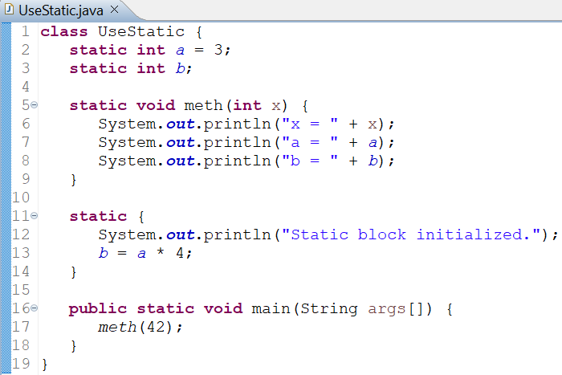
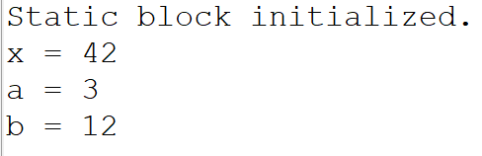
Understanding static: Example
OUTPUT
As soon as the UseStatic class is loaded, all of the static statements are run.
First, a is set to 3, then the static block executes, which prints a message and then initializes b to a*4, that is 12.
Then main() is called, which calls meth(), passing 42 to x.

Slide 8
Global Variables and Global Methods in Java
Static variables and methods can be used independently of any object outside of the class in which they are defined.
To do so, we need only specify the name of their class followed by the dot operator.
classname.staticVariable
classname.staticMethod()
This format is similar to that used to call non-static methods through object reference variables.
A static member can be accessed in the same way—by use of the dot operator on the name of the class.
This is how Java implements a controlled version of global variables and global methods.

Slide 9
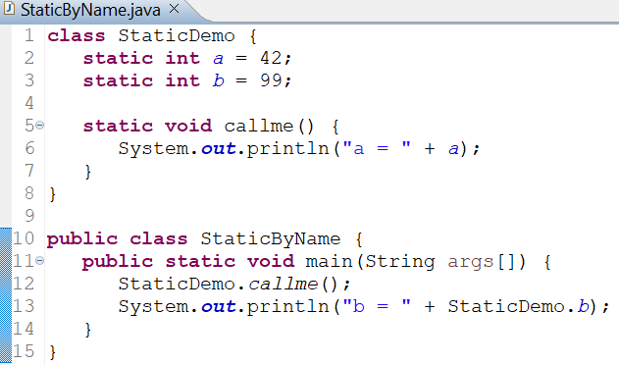

Global Variables and Global Methods in Java: Example
OUTPUT

Slide 10
Introducing final

Slide 11
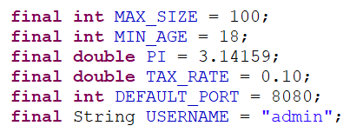
Introducing final
A field (i.e., member variable) can be declared as final, which prevents its contents from being modified, making it, essentially, a constant.
So, a final field must be initialized when it is declared. There are two ways for this:
It can be given a value when it is declared. (Most common way)
It can be assigned a value within a constructor.
It is a common coding convention to choose all uppercase identifiers for final fields.

Slide 12
Introducing final
In addition to fields, both method parameters and local variables can be declared final.
Declaring a parameter final prevents it from being changed within the method.
Declaring a local variable final prevents it from being assigned a value more than once.
The keyword final can also be applied to methods, but its meaning is substantially different than when it is applied to variables.
This additional usage of final will be discussed while learning inheritance.

Slide 13
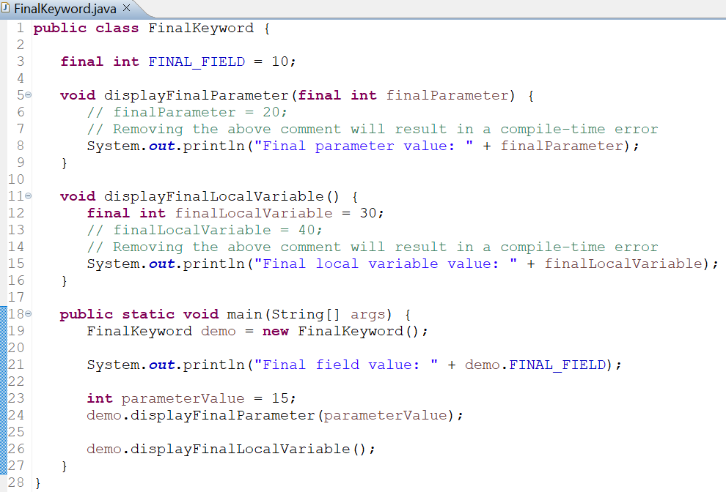
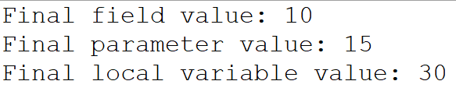
Introducing final
OUTPUT

Slide 14
Arrays Revised

Slide 15
Arrays Revisited
Arrays in Java are implemented as objects.
There is a special array attribute that we can take advantage of.
Specifically, the size of an array is found in its length instance variable.
The value of length reflects the number of elements that the array is designed to hold, not the number of elements that are actually in use.
All arrays have this variable.

Slide 16
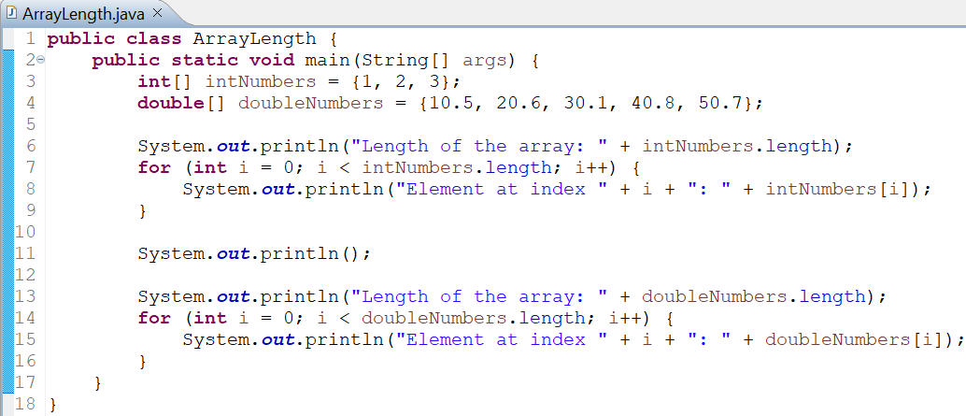
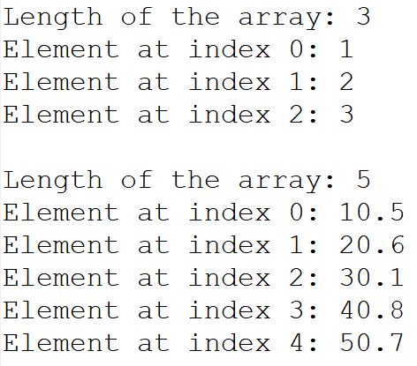
Arrays Revisited
OUTPUT

Slide 17
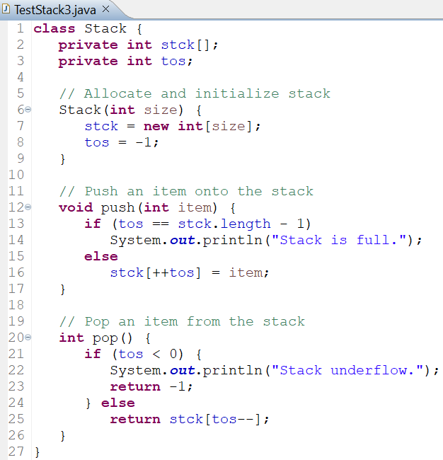
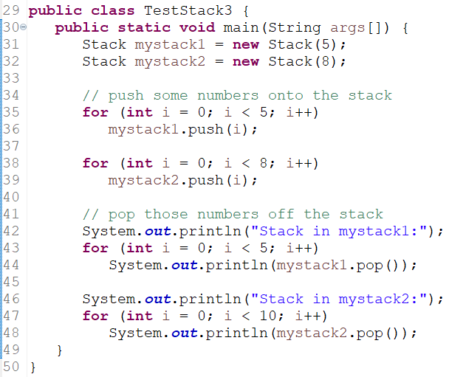
Stack Class Version 2.0
Stack class implementation utilizing the length instance variable.

